Slide 1
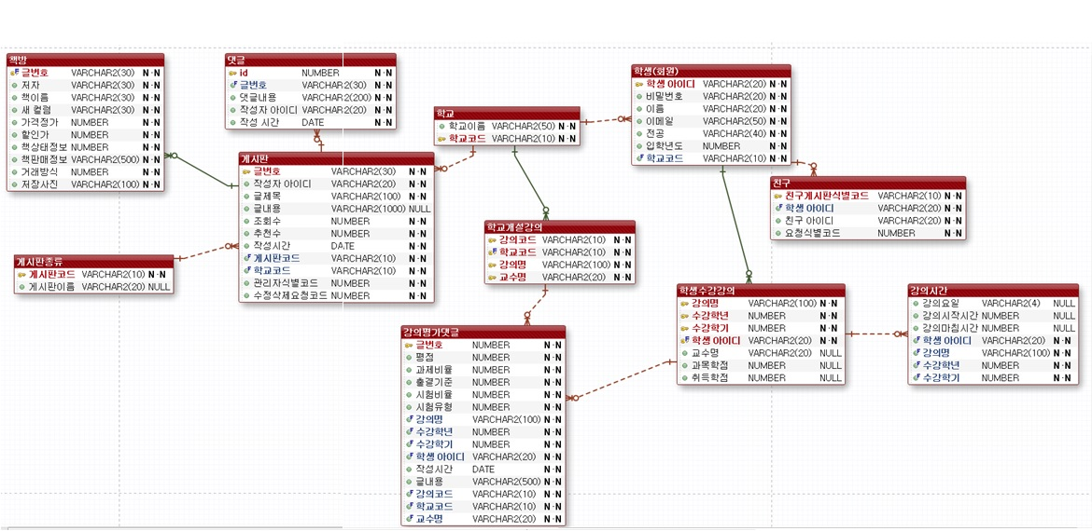
ER 모델 정의

Slide 2
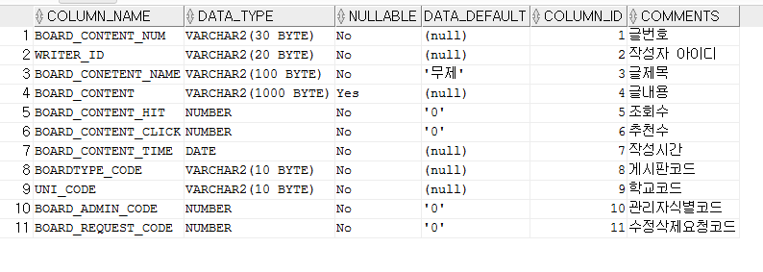
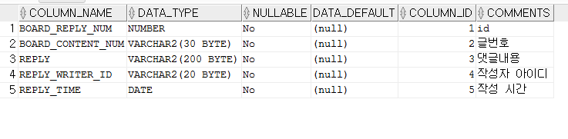
BOARD
BOARD_REPLY

Slide 3
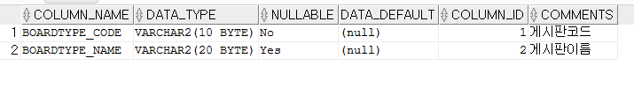
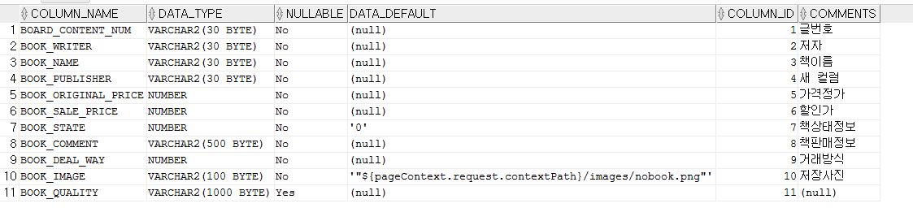
BOARDTYPE
BOOKSTORE_BOARD
책 품질

Slide 4

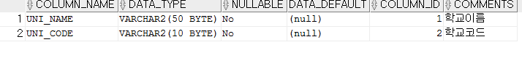
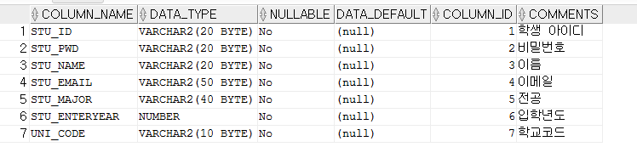
FRIEND
UNIVERSITY
STUDENT

Slide 5
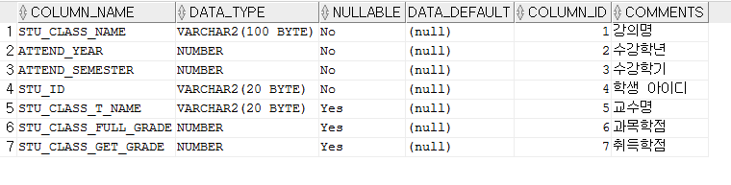
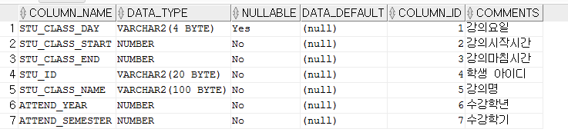
STU_CLASS
STU_CLASS_TIME

Slide 6

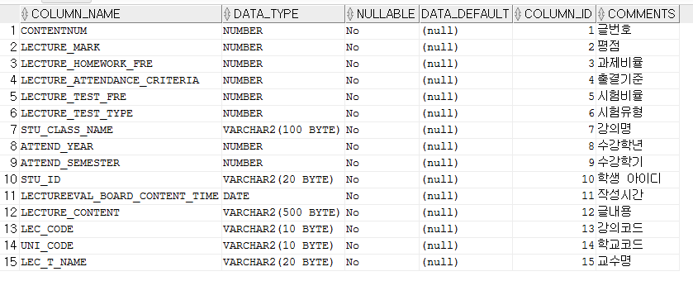
LECTURE
LECTUREEVAL_BOARD_REPLY

